Slide 1
CAPSTONE PROJECT -Integrated Electrical Maintenance Equipment Analysis (2018-2021)
Business in Brief:
Data is collected for a Cold Roll Mill of TATA STEEL, CRM produces steel sheets for various applications like automobile skin panel, corrugated sheets ..etc .
An Electrical agency maintains and fix any abnormality of electrical equipment and automation systems. It is also responsible for upgrades and commissioning of new systems introduced for increasing efficiency of process.

Slide 2
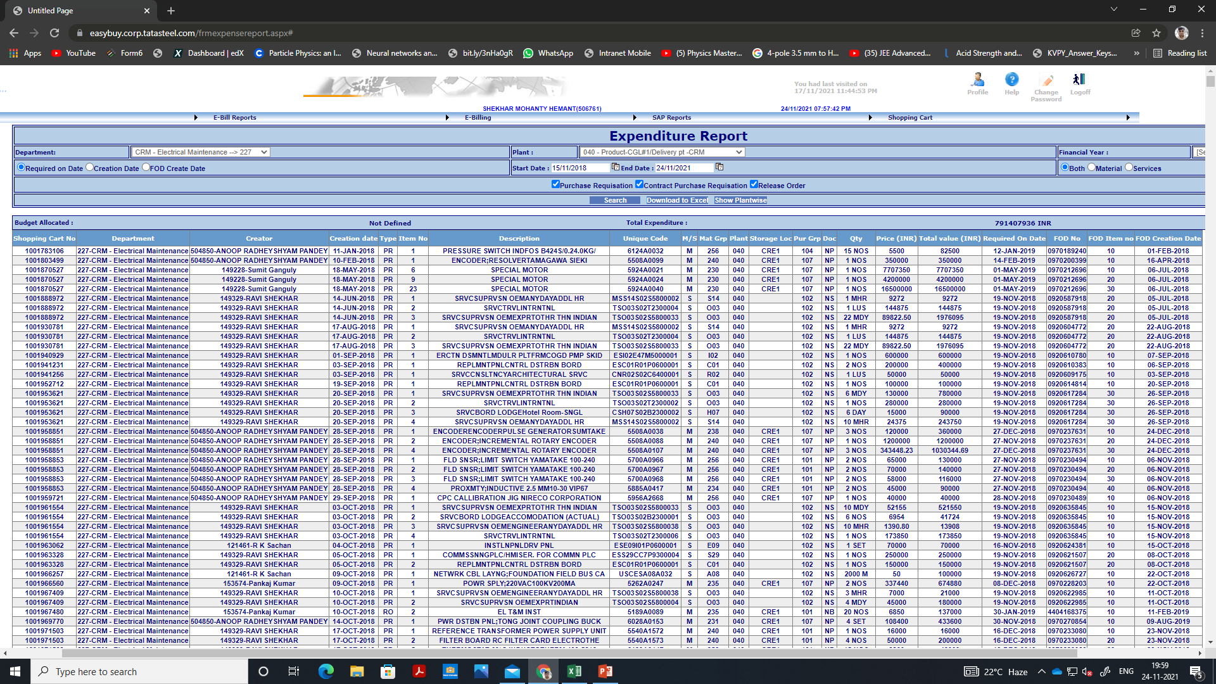
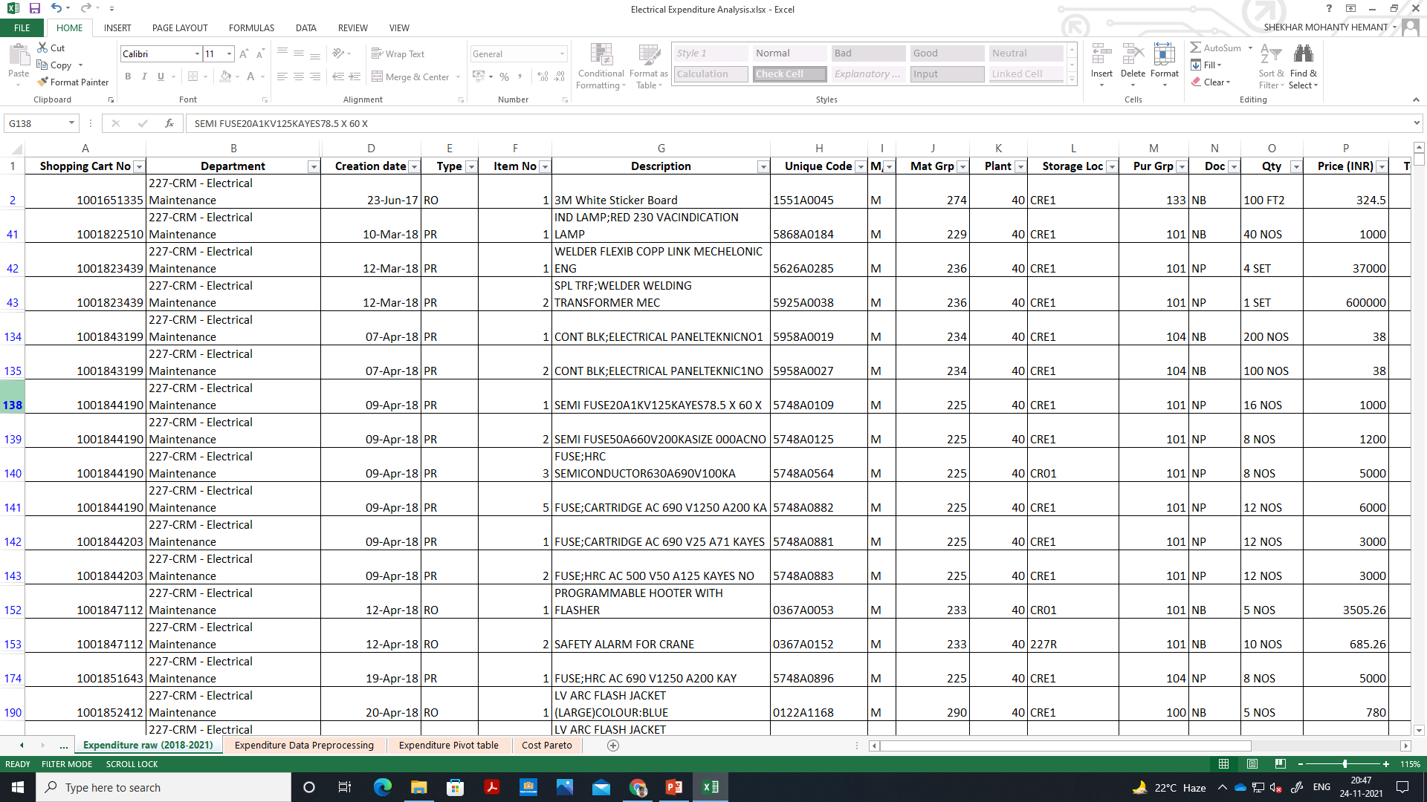
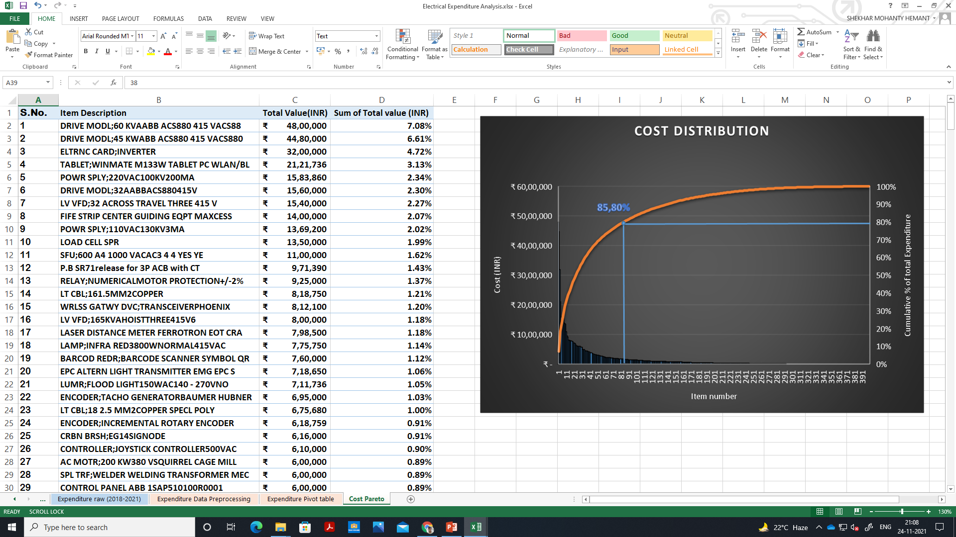
Data- Collection
RAW DATA FROM ERP SYSTEM
PRE-PROCESSING
CONSOLIDATED IN PIVOT TABLES
Raw data from ERP system of Expenditure on Electrical maintenance equipments over past 3 years of my department was exported in excel, pre-processing includes filtering raw data for my section(F&D) and deleting non electrical items.
I learned and used GitHub for working on my project from both home and office.

Slide 3
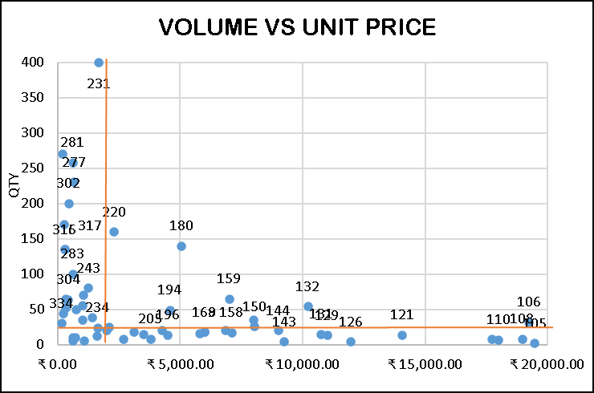
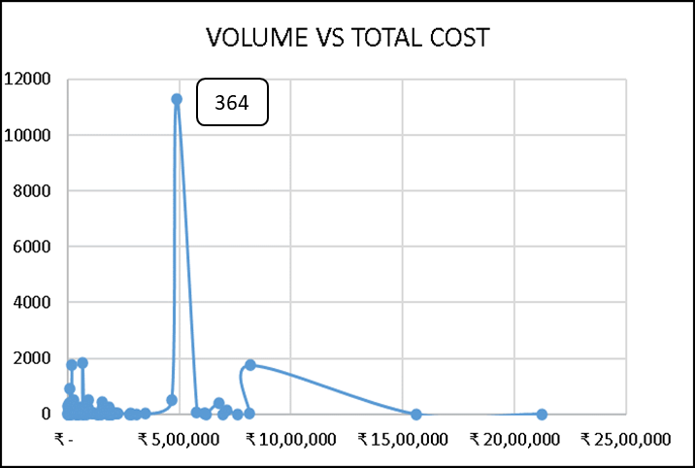
Analysis (Graphs and Charts) and interpretation

Slide 4
Analysis (Graphs and Charts) and interpretation

Slide 5
INSIGHTS AND RECOMMENDATIONs
The question I wanted to answer was failure rate of which equipments were higher.
To find which

